Slide 1


Chillax.AI
Stop Stressing, Start Understanding
Your offline, AI-powered code companion for untangling legacy systems
ET Gen AI Hackathon — Open Novel Innovation Category | Built for Hackathons 🚀

Slide 2



The Problem
Developers are drowning in code they didn't write.
75%
3+
0%
Time Reading Code
Weeks to Onboard
Code Leaving Machine
Not writing it
On legacy systems
Privacy-first
The Gap
Existing AI tools like GitHub Copilot and ChatGPT require sending proprietary code to external servers — unacceptable for enterprises in finance, healthcare, and defense.
"Enterprise codebases can't afford cloud-based AI assistants"
Tools exist to help developers write faster, but nothing helps them understand existing code at a system level.

Slide 3
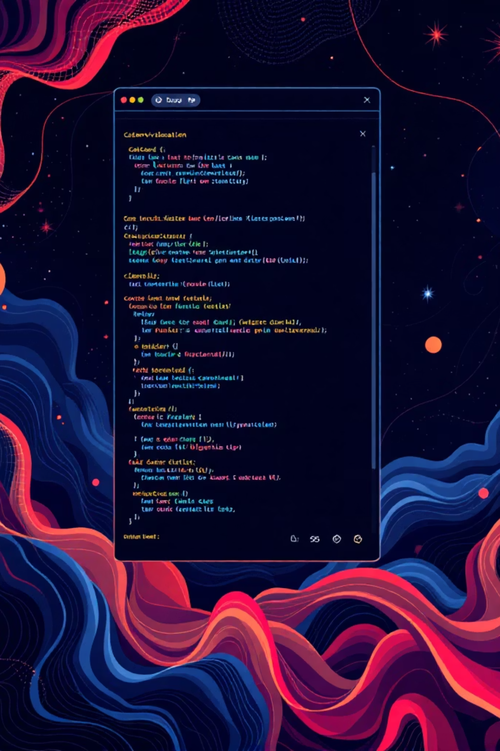

Our Solution
A standalone desktop IDE combining visual mapping, offline AI, and execution visualization.
Interactive Code Map
Offline AI Assistant
Visual graph showing all modules, functions, classes, and their relationships
LLaMA 3 running locally explains code in plain English with full context
Execution Visualizer
Animated walkthrough showing code flow with playback controls

Slide 4





How It Works
Visual Graph Theory + GenAI
Privacy-First Architecture
Unlike chatbots that just output text, Chillax.AI combines visual mapping with AI comprehension — we show code execution visually.
All code analysis and AI processing happens 100% offline on the developer's local machine.
Zero data leaves the machine. No cloud dependencies. No proprietary code exposed.
Load Codebase
Analyze Structure
Ask Questions
Understand Instantly
Success metric: 60% reduction in code comprehension time

Slide 5
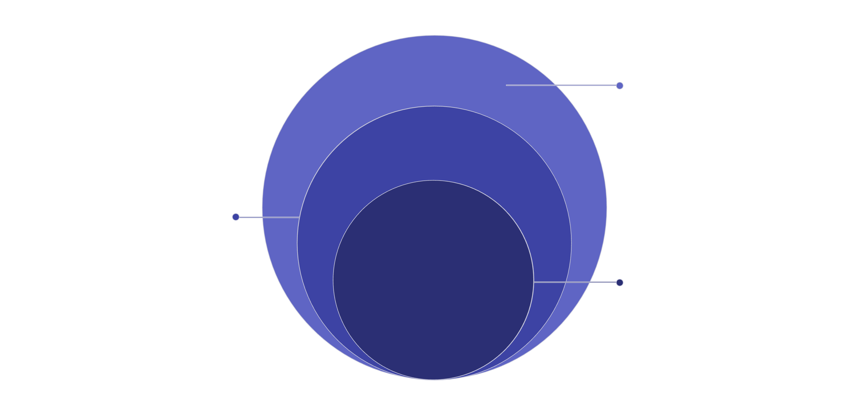

Technical Architecture
Three-Layer Neuro-Symbolic Approach
GenAI + Viz
Generate explanations and interactive visualizations
Knowledge Graph
Represent relations and feed graph to GenAI
Symbolic Analysis
Parse code into AST and extract semantics
Tech Stack: Electron, React 18, Vite, Monaco Editor, FastAPI, Python AST, Ollama, React Flow, Custom dark theme CSS

Slide 6
Validation Strategy
Three complementary approaches to prove effectiveness.
1
Accuracy Testing
2
Performance Benchmarking
3
User Study
Compare AI-generated explanations against ground-truth AST dependency graphs
Simulated onboarding tasks measuring time-to-discovery with vs. without Chillax.AI
Measure inference latency targeting sub-5-second responses on standard laptops

Slide 7
Target Users & Use Cases
Privacy-Sensitive Industries
Legacy System Maintainers
Computer Science Educators
Banking, healthcare, and defense teams working with proprietary, classified, or regulated codebases that cannot leave local machines.
Engineers supporting decade-old codebases that lack documentation but power critical business operations.
Professors and TAs using visualization to teach students how complex systems actually work.
Use Case Scenario
A developer joins a team with a massive, undocumented 10-year-old Python codebase. They open Chillax.AI, visualize the architecture as an interactive graph, and ask "How does the payment module work?" — all without data leaving their machine.

Slide 8


Why Chillax.AI?
Neuro-Symbolic Innovation
Combine deterministic AST parsing with probabilistic LLMs to reduce hallucinations and increase accuracy.
Truly Offline by Design
Privacy and security aren't features — they're fundamental to our architecture. No cloud dependencies.
Visual Execution Flow
Go beyond text explanations with animated code execution visualization showing exactly how systems work.
Language-Agnostic Future
Python-first, but architecture adapts to JavaScript, Java, C++, Go, and more. Universal legacy platform.
Novelty: Visual Graph Theory + GenAI
This hybrid approach allows us to show code execution visually within a unified interface where developers simultaneously explore architecture graphs, engage the AI assistant, and watch animated execution traces — all on their local machine.
GitHub: [your-github-link] | Team: [your-team-name] | Contact: [your-email]

Slide 9


Take the Stress Out of Legacy Code
Chillax.AI
Built for the ET Gen AI Hackathon — Open Innovation Category
Team: [Team Name] | Contact: [Team Email]

